Slide 1
Data Collection ——Data Labeling——
“Data Mining: Methods and Applications”

Slide 2
Contents
Background
Data Acquisition
Data Labeling
Improvement of Existing Data and Models
How to Decide which Data Collection Techniques to Use When
Interesting Future Research Challenge

Slide 3
Data labeling
The goal of data labeling is to label individual examples.
The following categories for understanding the data labeling landscape.
Use existing labels: An early idea of data labeling is to exploit any labels that already exist.
Crowd-based: The next set of techniques are based on crowdsourcing.
Weak labels: While it is desirable to generate correct labels all the time, this process may be too expensive.
Each labeling approach can be further categorized as follows: Machine learning task and Data type.

Slide 4
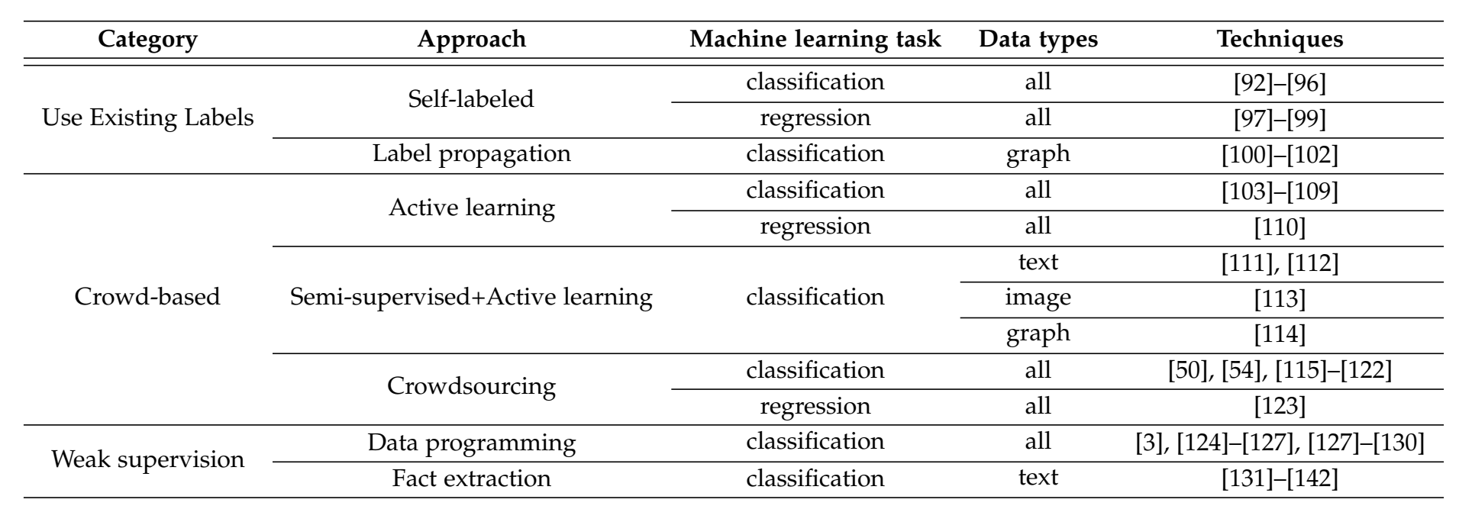
Data labeling
A classification of data labeling techniques. Some of the techniques can be used for the same application. For example, for classification on graph data, both self-labeled techniques and label propagation can be used. .

Slide 5
Data labeling
Utilizing existing labels
Classification : For semi-supervised learning techniques for classification, the goal is to train a model that returns one of multiple possible classes for each example using labeled and unlabeled datasets.
Regression : Relatively less research has been done for semi-supervised learning for regression where the goal is to train a model that predicts a real number given an example.
Graph-based Label Propagation : Graph-based label propagation techniques also start with limited sets of labeled examples, but exploit the graph structure of examples based on their similarities to infer the labels of the remaining examples.

Slide 6
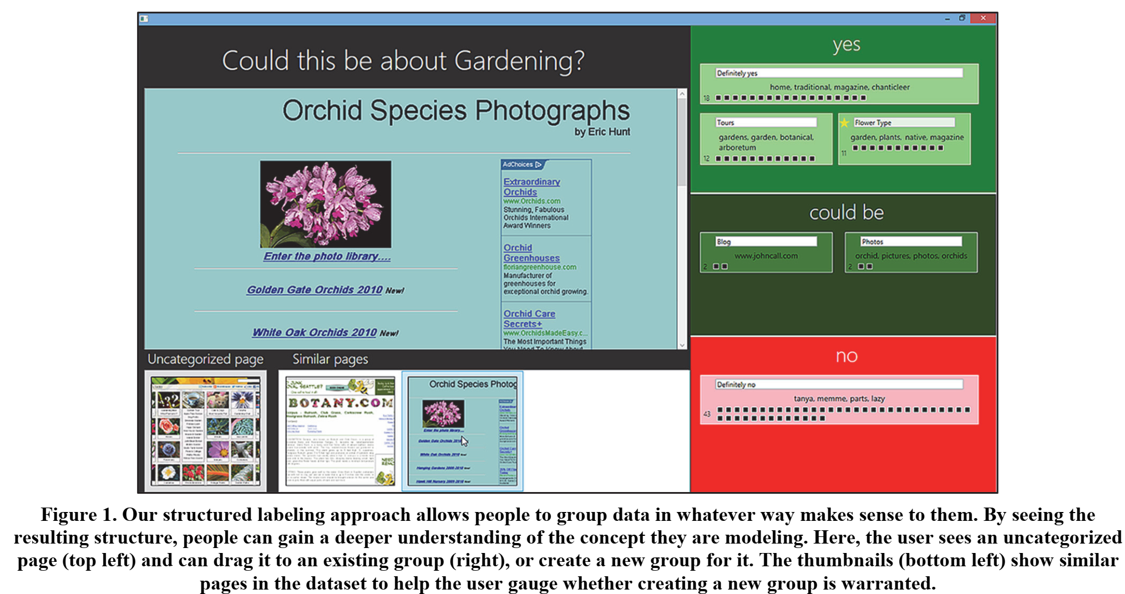
Data labeling
Utilizing existing labels

Slide 7
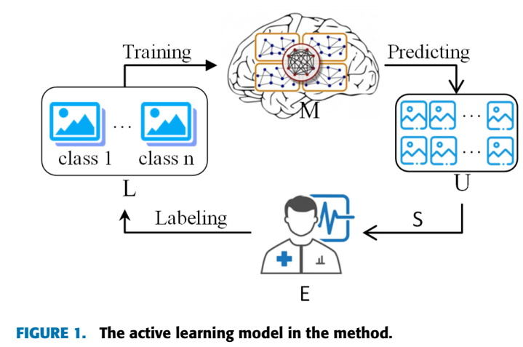
Data labeling
Crowd-based techniques
Active Learning : Active learning focuses on selecting the most “interesting” unlabeled examples to give to the crowd for labeling.
Uncertain Examples Uncertainty Sampling is the simplest in active learning and chooses the next unlabeled example that the model prediction is the most uncertain.
Decision Theoretic Approaches Another line of active learning performs decision-theoretic approaches. Decision theory is a framework for making decision under uncertainty using states and actions to optimize some objective function.

Slide 8
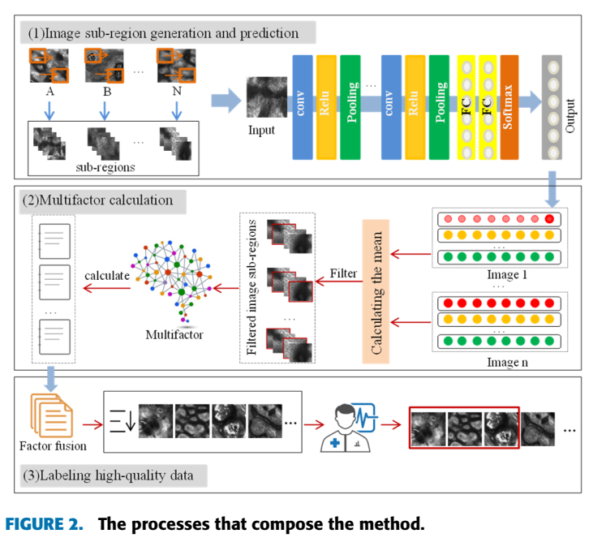
Data labeling
Regression Active learning techniques can also be extended to regression problems.
Self and Active Learning Combined The data labeling techniques we consider are complementary to each other and can be used together. A key observation is that the two techniques solve opposite problems where semi-supervised learning finds the predictions with the highest confidence and adds them to the labeled examples while active learning finds the predictions with the lowest confidence (using uncertainty sampling, query-by-committee, or density-weighted method) and sends them for manual labeling.

Slide 9
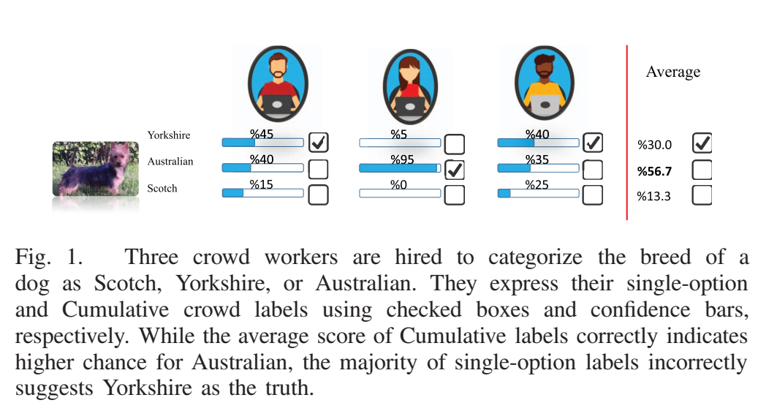
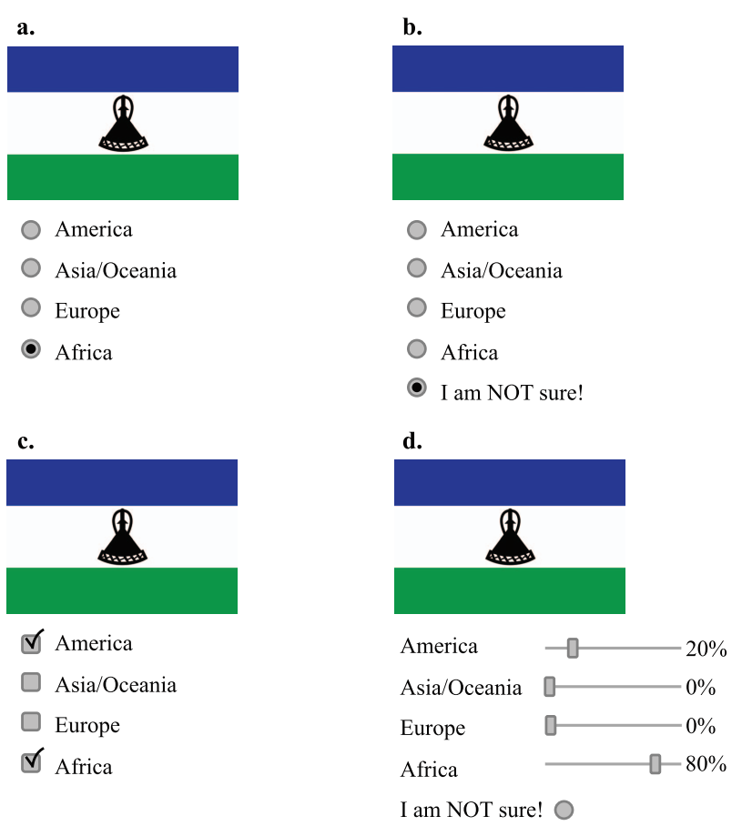
Data labeling
Crowd-based techniques
Crowdsourcing : the crowdsourcing techniques here are more focused on running tasks with many workers who are not necessarily labeling experts.
User Interaction :A major challenge in user interaction is to effectively provide instructions to workers on how to perform the labeling.
Quality control : A simple way to ensure quality is to repeatedly label the same example using multiple workers and perhaps take a majority voting at the end.
Scalability : Scaling up crowdsourced labeling is another important challenge.

Slide 10
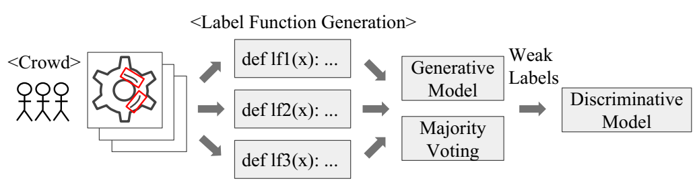
Data labeling
Weak Supervision : it is mostly the case that there is not enough labeled data.
Data Programming: As data labeling at scale becomes more important especially for deep learning applications, data programming has been proposed as a solution for generating large amounts of weak labels using multiple labeling functions instead of individual labeling.
A workflow of using data programming for a smart factory application. In this scenario, Sally is using crowdsourcing to annotate defects on component images. Next, the annotations can be automatically converted to labeling functions. Then the labeling functions are combined either into a generative model or using majority voting. Finally, the combined model generates weak labels that are used to train a discriminative model.

Slide 11



Data labeling
Weak Supervision
Fact Extraction: Another way to generate weak labels is to use fact extraction. Knowledge bases contain facts that are extracted from various sources including the Web. A fact could describe an attribute of an entity (e.g., Germany, capital, Berlin).
Knowledge Base: Freebase, Google Knowledge Graph and YAGO.

Slide 12
Contents
Background
Data Acquisition
Data Labeling
Improvement of Existing Data and Models
How to Decide which Data Collection Techniques to Use When
Interesting Future Research Challenge

Slide 13
Thanks！
Notes:
工作新意图发现

